Slide 1
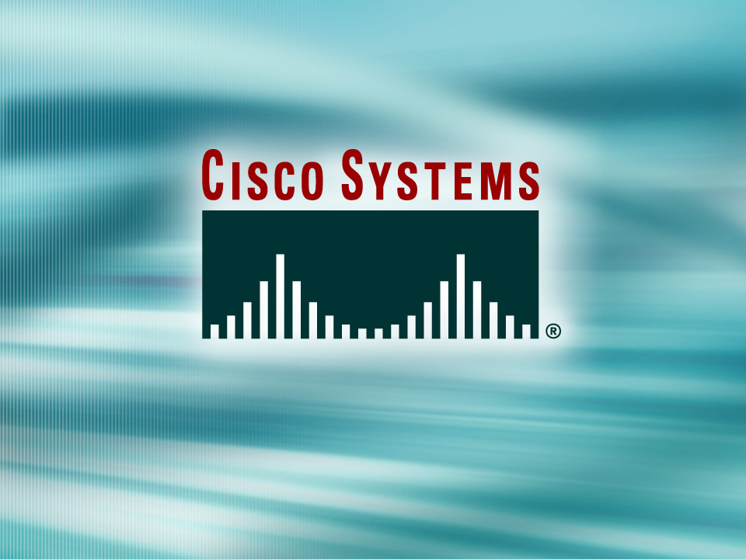
© 2002, Cisco Systems, Inc. All rights reserved.

Slide 2

Configuring a Router
© 2002, Cisco Systems, Inc. All rights reserved.
Notes:
Purpose: This chapter introduces the Cisco IOS™ CLI on the Catalyst® 1900 switch and router.
Timing: This chapter should take about 2 hours to present.
Note: The Catalyst 1900 switch only has a subset of the router Cisco IOS commands available.
Contents:
Introduction to Cisco IOS. Explain to the student what is IOS?
Cisco Device startup procedures in general.
IOS configuration source.
General introduction to the IOS CLI.
Cat 1900 switch startup procedures.
Intro to Cat 1900 CLI. This part covers the basic configuration on the switch, like setting the IP address and hostname. More details about the various Cat 1900 switch configuration commands are explained in Chapter 6 and 7.
Router startup procedures. More details on the router startup process is discussed in chapter 5.
Router IOS CLI.

Slide 3
Objectives
Upon completing this lesson, you will be able to:
  Use the CLI to interact with the Cisco IOS software, given an operational router
  Verify the default configuration of the device, given a functioning router
  Complete the initial device configuration, given
  a functioning router
  Configure IP addresses and IP subnet masks on router interfaces, given a functioning router
Notes:
Slide 1 of 2
Purpose: This slide states the chapter objectives.
Emphasize: Read or state each objective so that each student has a clear understanding of the chapter objectives.
Note: Catalyst switches have different CLIs. The Catalyst 2900xl and the Catalyst 1900 has a Cisco IOS CLI. The Cisco IOS CLI commands available on the 2900xl is different from the 1900. The Catalyst 5000 family has no Cisco IOS CLI, and use the set commands instead. This class only covers the configuration on the Catalyst 1900 switch.

Slide 4
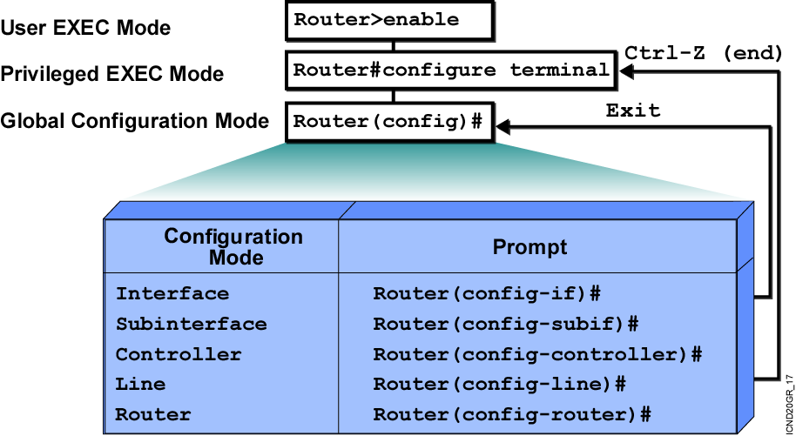
Overview of Router Modes
Notes:
Emphasize: Here is a list of some of the configuration modes available.
For a complete list of the router configuration modes, refer to the Cisco Documentation CD-ROM.

Slide 5
Saving Configurations
wg_ro_c#
wg_ro_c#copy running-config startup-config
Destination filename [startup-config]?
Building configuration…
wg_ro_c#
  Copies the current configuration to NVRAM
Notes:
Emphasize: Copying to NVRAM overwrites the contents in NVRAM.

Slide 6
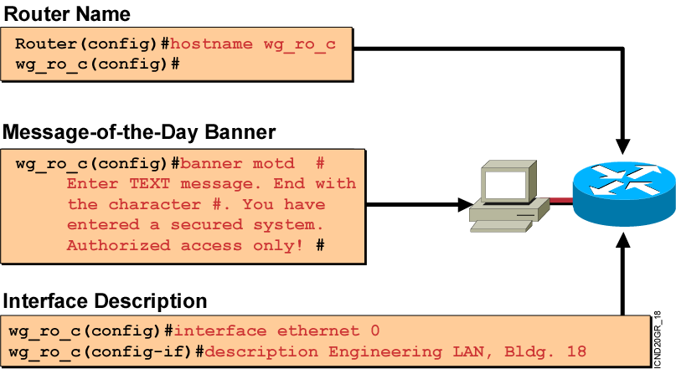
Configuring Router Identification
  Sets the local identity or message for the accessed router or interface
Notes:
Slide 2 of 2
Emphasize: Layer 2—The interface description command allows you to enter a one-line descriptive statement for each interface. This description is displayed in the output from the show interfaces command and appears in the show running-config and show startup-config listings.

Slide 7
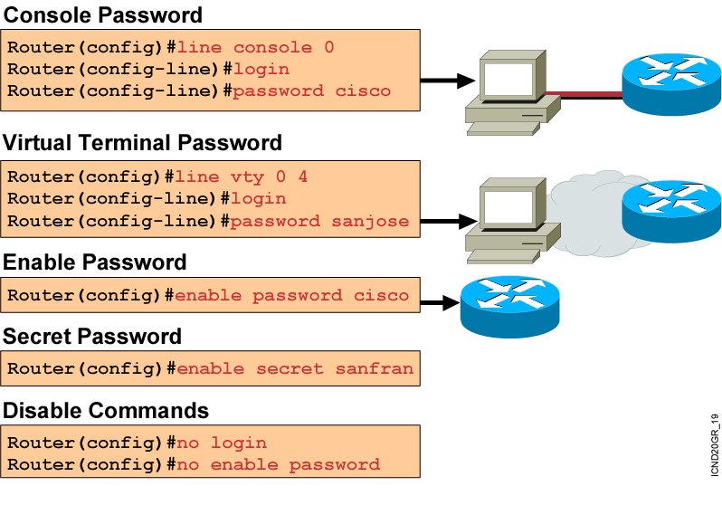
Configuring a Router Password
Notes:
Layer 2 of 2
Emphasize: The router has one enable password. Remember that this is your only protection. Whoever owns this password can do anything with the router, so be careful about communicating this password to others. To provide an additional layer of security, particularly for passwords that cross the network or are stored on a TFTP server, you can use either the enable password or enable secret commands. Both commands accomplish the same thing; that is, they allow you to establish an encrypted password that users must enter to access enable mode (the default), or any privilege level you specify. Cisco recommends that you use the enable secret command because it uses an improved encryption algorithm. Use the enable password command only if you boot an older image of the Cisco IOS software, or if you boot older boot ROMs that do not recognize the enable secret command. If you configure the enable secret password, it is used instead of the enable password, not in addition to it.
Cisco supports password encryption. Turn on password encryption using the service password-encryption command. Then enter the desired passwords for encryption. Immediately, on the next line, enter the no service password-encryption command. Only those passwords that are set between the two commands will be encrypted. If you enter service password-encryption and then press Ctrl-Z to exit, all passwords will be encrypted.
Note: Password recovery is not covered in the course materials. Refer the students to the IMCR class.

Slide 8
Other Console-Line Commands
Router(config)#line console 0
Router(config-line)#exec-timeout 0 0
  Prevents console session timeout
Router(config)#line console 0
Router(config-line)#logging synchronous
  Redisplays interrupted console input
Notes:
Emphasize: If the student enters no exec by mistake, the console port EXEC mode will be disabled once the student is logged out of the current session. If this happens, you have to break into the router using ROM monitor to recover (set the config reg to 0x2142 so it will ignore NVRAM).

Slide 9
Configuring an Interface
Router(config)#interface type number
Router(config-if)#
  type includes serial, ethernet, token ring, fddi, hssi, loopback, dialer, null, async, atm, bri, tunnel, and so on
  number is used to identify individual interfaces
Router(config)#interface type slot/port
Router(config-if)#
  For modular routers, selects an interface
Router(config-if)#exit
  Quits from current interface configuration mode
Notes:
Purpose: This slide shows the interface configuration mode.
Emphasize: The top line is the format of the command used in fixed-port routers. The type field shows the interface type, which can be Ethernet, Token Ring, or another interface. The number field is the number of the interface. For example, if the router has two Ethernet interfaces, and one is known as Ethernet0, the other will be called Ethernet1.
The second command is used on the Cisco 7000 and 7200 series routers, which can accept multiple interface cards with multiple ports on each card. In this case, the first number is the number of the card, or slot number. The second number is the port on the card. For example, on the second interface card, the first Ethernet interface is specified as Ethernet 2/0.
If you have Cisco 7000 and 7500 series routers with VIP cards, you define an interface by slot, port adapters, and port numbers. Port adapters are assigned either a 0 or 1 number.
Use the exit command to leave the current configuration mode.

Slide 10
Configuring a Serial Interface
Enter Global
Configuration Mode
Router#configure terminal
Router(config)#
Specify Interface
Router(config)#interface serial 0
Router(config-if)#
Set Clock Rate
(on DCE interfaces only)
Router(config-if)#clock rate 64000
Router(config-if)#
Router(config-if)#bandwidth 64
Router(config-if)#exit
Router(config)#exit
Router#
Set Bandwidth
(recommended)
Notes:
Layer 2 of 2
Purpose: This slide shows two configuration parameters for the serial interface.
Emphasize: Layer 2— Issue the clock rate command with the desired speed. On serial links, one side of the link acts as the DCE and the other side of the link acts as the DTE. By default, Cisco routers are DTE devices, but can be configured as DCE devices. In a “back-to-back” cable configuration where a modem is not used, one end must provide the clocking signal. You must specify a clock rate for the DCE interface end in this type of environment. Desired clock rate is in bits per second. Be sure to enter the complete clock speed. For example, a clock rate of 56000 cannot be abbreviated to 56. If you are using an EIA/TIA-232 cable, using a high clock rate may cause errors on the line. Use the show controller serial 0 command to verify if the router has a DCE or DTE cable connected to it. Note, the router only reads the DCE/DTE cable information at startup.
The bandwidth command overrides the default bandwidth (1.544M). The bandwidth parameter (in kbps) is used to calculate statistics like load and it is used by routing protocols such as IGRP. We will learn more about routing protocols in Chapter 9, “Determining IP Routes.”
To return to privileged EXEC mode, enter exit until the privileged EXEC prompt appears.
Note: In the lab, the core router has the DCE cables and the workgroup router has the DTE cable.

Slide 11
Ethernet media-type Command
Router(config)#interface ethernet 2
Router(config-if)#media-type 10baset
Selects the media-type connector for the
Ethernet interface
Notes:
Purpose: This slide shows examples of the commands used to configure other types of interfaces.
Note: The 2500 series router will auto-sense between the AUI or the 10BaseT port. Routers like the 4000 series router default to the AUI port and you have to use the media-type command to specify 10BaseT.

Slide 12
Disabling or Enabling an Interface
Router#configure terminal
Router(config)#interface serial 0
Router(config-if)#shutdown
%LINK-5-CHANGED: Interface Serial0, changed state to administratively down
%LINEPROTO-5-UPDOWN: Line protocol on Interface Serial0, changed state to down
Administratively turns off an interface
Router#configure terminal
Router(config)#interface serial 0
Router(config-if)#no shutdown
%LINK-3-UPDOWN: Interface Seria0, changed state to up
%LINEPROTO-5-UPDOWN: Line Protocol on Interface Serial0, changed state to up
Enables an interface that is administratively shut down
Notes:
Emphasize: The Catalyst 1900 switch also uses the shut and no shut command.

Slide 13
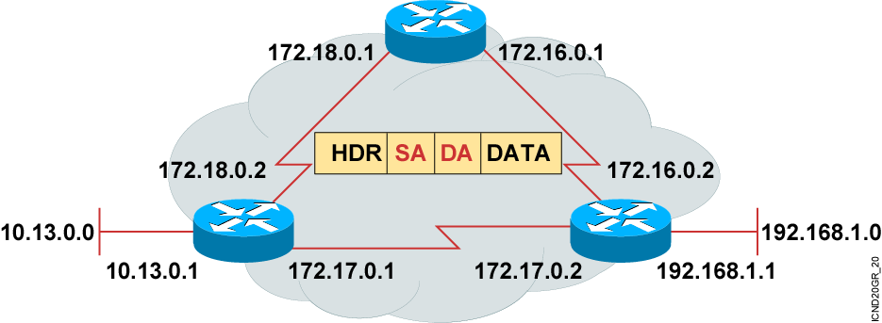
Introducing IP Addresses
  Unique addressing allows communication
  between end stations.
  Path choice is based on destination address.
Location is represented by an address
Notes:
Purpose: This is an introduction slide to the IP addressing section.
Emphasize: Stations with internetwork access must have unique addresses.

Slide 14
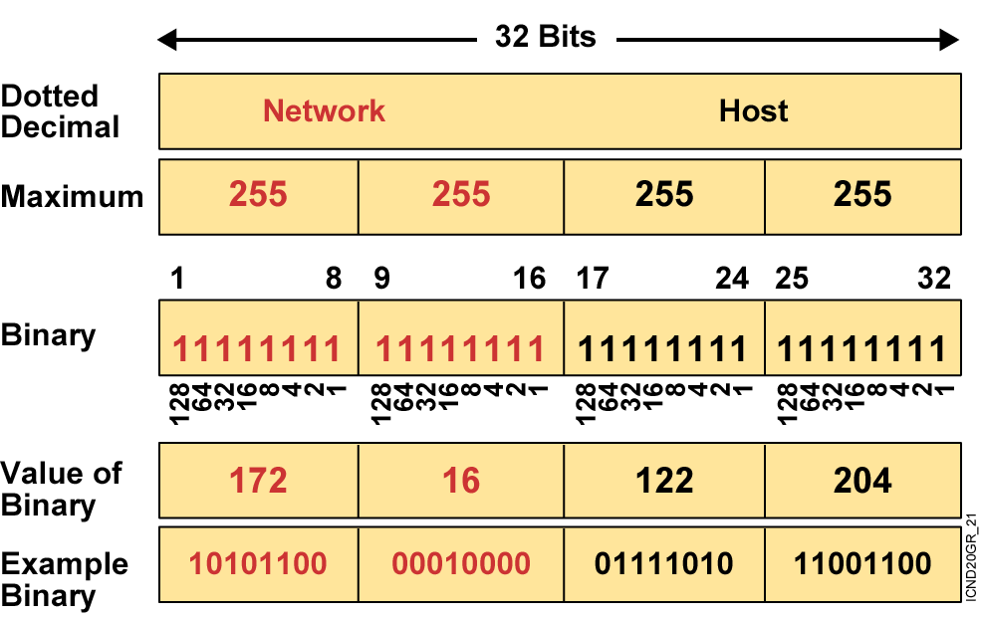
IP Addressing
Notes:
Layer 3 of 3
Emphasize: In layer 3, an example of dotted decimal format and binary are displayed.
IP address format is dotted decimal. Dotted decimal makes it easy to work with IP addresses. However, in this course we will work with the addresses on the bit level, so we will convert these addresses into binary, make changes to them, and convert them back.
The central authority for addresses is the Internet Assigned Numbers Authority (IANA).
Note: This most common form of addressing reflects the widely used IP version 4. Faced with the problem of depleting available addresses, Internet Engineering Task Force (IETF) work is under way for a backward-compatible next generation of IP (IPng, also called IP 6).
IP 6 will offer expanded routing and addressing capabilities with 128-bit addresses rather than the 32-bit addressing shown on the graphic. Addresses from both IP versions will coexist. Initial occurrences will probably be at locations with address translator software and firewalls.

Slide 15
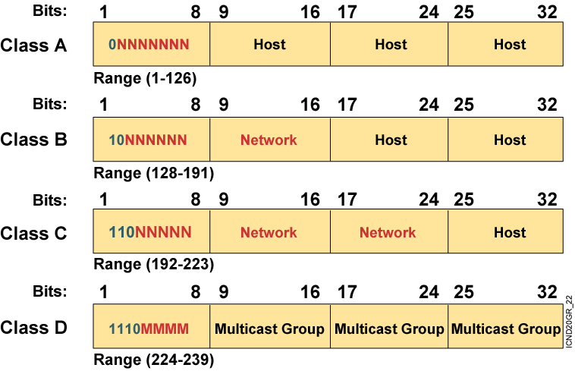
IP Address Classes
Notes:
Slide 2 of 2
Emphasize: Highlight the fixed values that start each class address.
The first octet rule states that when an address falls into a specified range, it belongs to a certain class. Students should soon be able to recognize the address class of any IP address on sight.
Note: If time or interest permits, you can use the initial bit patterns in the first octet and show how a class of IP network derives the range of network numbers for that IP address class.

Slide 16
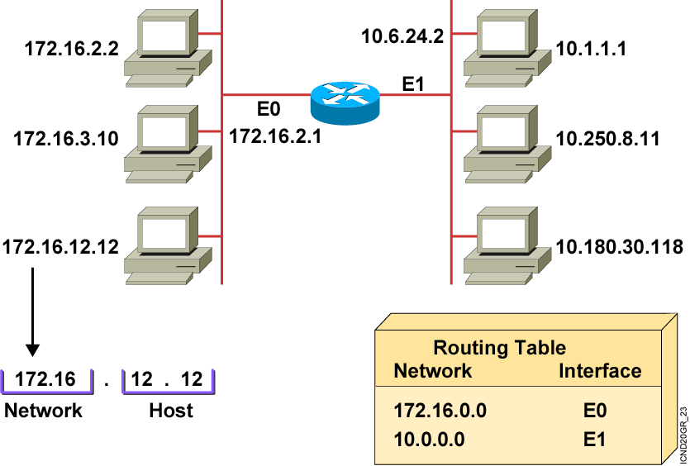
Host Addresses
Notes:
Purpose: This figure presents an overview of host and network address conventions.
Emphasize: In the example, 172.16.0.0 and 10.0.0.0 refer to the wires at each end of the router.
Explain how the routing table is used. Entries in the routing table refer to the network only. The router does not know the location of hosts; it knows the location of networks.
.

Slide 17
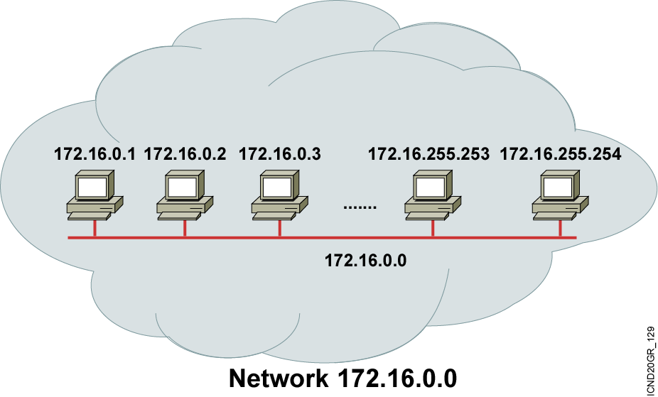
Addressing Without Subnets
Notes:
Purpose: This figure explains what networks look like without subnets.
Emphasize: Without subnets, use of network addressing space is inefficient.
The Class B network is like a highway with no exits—there is no place to exit, so all of the traffic is in one line.

Slide 18
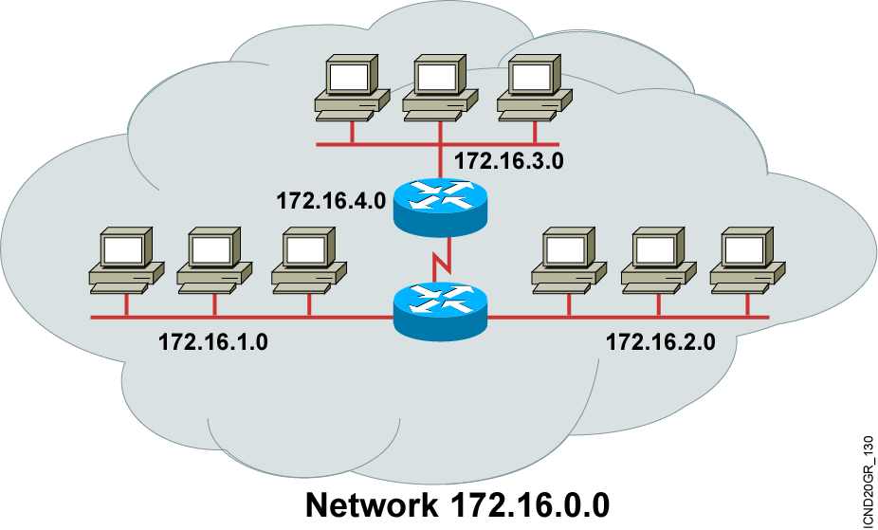
Addressing with Subnets
Notes:
Purpose: This figure describes network structure when subnets are used.
Emphasize: The host bits of an IP address can be subdivided into a subnetwork section and a host section. The subnetwork section in this example is the full third octet.
Point out the difference in the addressing between the previous slide and this slide.
A subnetted address space is like a highway with exits.
A network device uses a subnet mask to determine what part of the IP address is used for the network, the subnet, and the device ID.
A subnet mask is a 32-bit value containing a number of one bits for the network and subnet ID, and a number of zero bits for the host ID.
Given its own IP address and subnet mask, a device can determine if an IP packet is destined for 1) a device on its own subnet, 2) a device on a different subnet on its own network, or 3) a device on a different network.
A device can determine what class of address the device has been assigned from its own IP address. The subnet mask then tells the device where the boundary is between the subnet ID and the host ID.

Slide 19
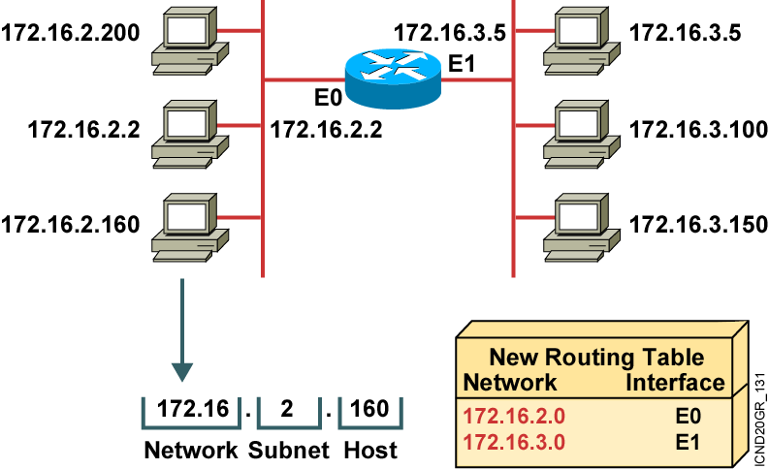
Subnet Addressing
Notes:
Layer 1 of 2
Emphasize: By turning on more bits in the mask, we reserve some bits as network information and can use these bits to describe subnetworks.
Describe how the router makes use of this technique. Point out that there is more information in the routing table now.
Note: As you enter the discussion about subnet masks, a question might arise about whether it is legal to define a discontiguous subnet mask. A discontiguous subnet mask consists of intervening zeros, as in 101111011000, rather than all ones followed by zeros, as in 1111111100000000. The question has two answers. According to RFC 950 that describes IP, a discontiguous subnet mask is legal. However, the hardware expense to produce an interface that supports discontiguous masking is cost prohibitive. Thus in practice it is not supported on most vendors’ equipment, including Cisco. Also, discontiguous masking has no benefit, and it is much more difficult to maintain a network based on this design. Later RFCs make noncontiguous subnet masks illegal because they are incompatible with future addressing schemes such as CIDR.

Slide 20
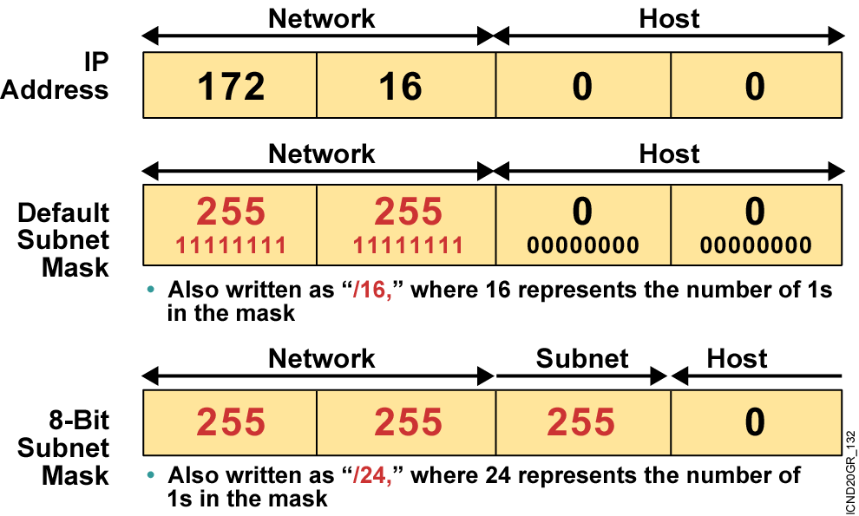
Subnet Mask
Notes:
Emphasize: Turn on more bits to represent subnets.
Compare the default or standard subnet mask with the subnet mask in the slide.
The following are the rules for IP addressing:
An address is 32 bits, divided into three components:
First octet rule bits
Network bits (path selection bits)
Node bits
The first octet rule states that the most significant bit pattern in the first octet determines the class of the address.
Path selection bits cannot be all ones or zeros.
Certain addresses are reserved. RFC 1918 defines some of those.
Prefix or mask one bits are path selection significant; zero bits are host bits and therefore not significant.
Use the logical AND to combine the address and mask bits to get the subnet address.
The maximum number of available subnets equals 2 prefix bits - 2; the maximum number of available hosts equals 2 32- prefix bits - 2.

Slide 21
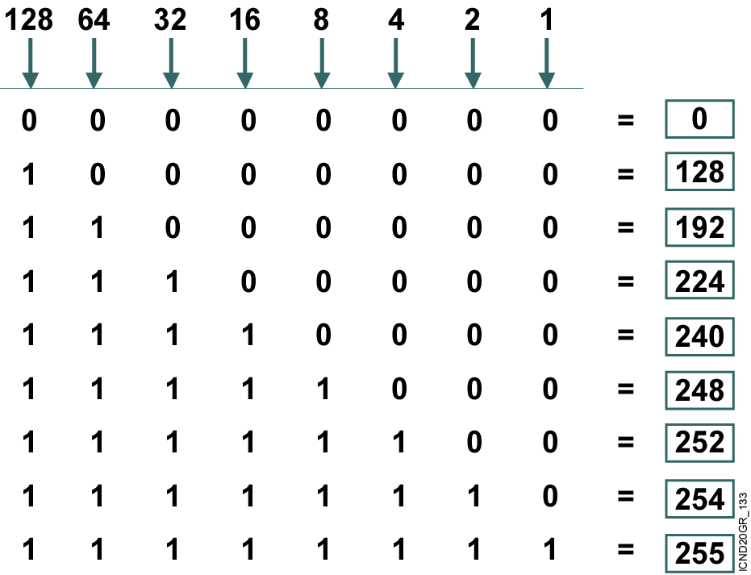
Decimal Equivalents of Bit Patterns
Notes:
Purpose: This figure explains how subnet masks are converted to decimal addresses.
Emphasize: Review binary-to-decimal conversion, bit weighting, and conversion.
Explain the logical AND.
One possible explanation of the logical AND follows. We will need to be able to perform a logical AND on the binary numbers. Just take two binary numbers and place one above the other. The ones in the bottom are like a pipe—the number above it just drops through. The zeros are like a clogged pipe, so nothing comes out in the answer.
Presenting a truth table will help some students understand. You might need to give more than one explanation.
Note: You might want to hand out a binary-to-decimal conversion sheet if you have not already done so. We have not included one in the lab section. It is more useful to have one that is on a separate page from the labs.

Slide 22
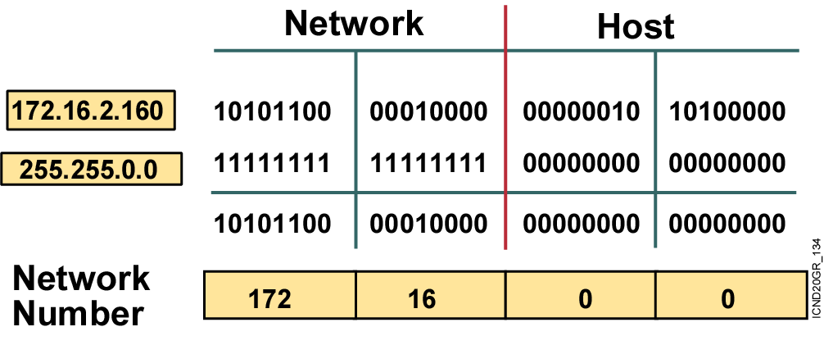
Subnet Mask Without Subnets
Subnets not in use—the default
Notes:
Purpose: This graphic explains how routers use addresses that have no subnet mask.
Emphasize: Explain how masking works at the bit level. Zero bits mask host information.
Note: This is an easy place to lose students. At this point, they need to learn several abstract mathematical concepts before we can show them how to lay out an IP-addressed network. To the novice, these techniques may seem unrelated, making the presentation confusing. To a more experienced audience, these techniques will be familiar.

Slide 23
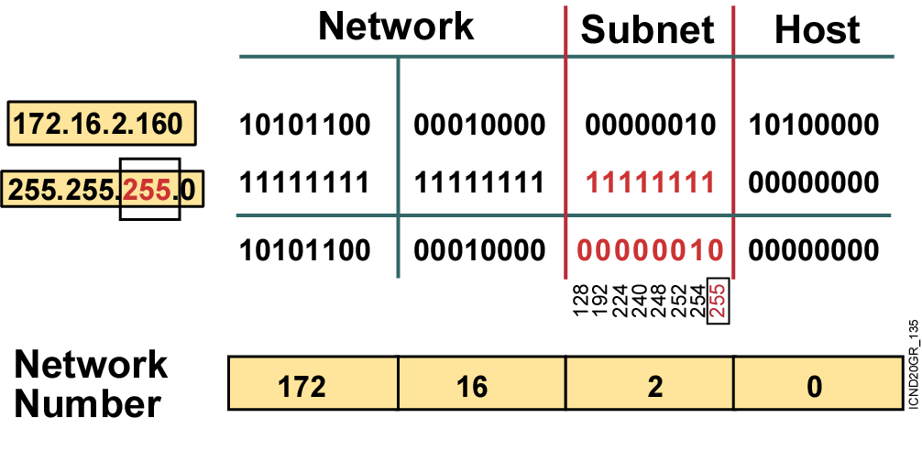
Subnet Mask with Subnets
Network number extended by eight bits
Notes:
Slide 1 of 2
Purpose: This figure shows how the router determines an address when subnetting is used.
Emphasize: This example makes a Class B address space look like a collection of Class C address spaces.
Now the logical AND allows us to extract the subnet number as well as the assigned network number.
An exercise follows that tests the students’ understanding of subnet masks.

Slide 24
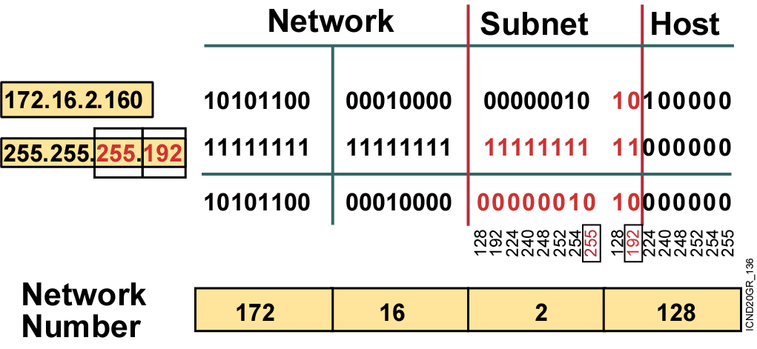
Subnet Mask with Subnets (Cont.)
Network number extended by ten bits
Notes:
Slide 2 of 2
Purpose: This figure shows how the router determines an address when subnetting is used.
Emphasize: This example is different from the previous example in that the the subnet and host are divided within an octet.
Transition: An exercise follows that tests the students’ understanding of subnet masks.

Slide 25
Configuring the Router IP Address
wg_ro_c#configure terminal
wg_ro_c(config)#interface ethernet 0
wg_ro_c(config-if)#ip address 192.168.1.1 255.255.255.0
wg_ro_c(config-if)#no shutdown
wg_ro_c(config-if)#exit

Slide 26
Router show interfaces Command
Router#show interfaces
Ethernet0 is up, line protocol is up
Hardware is Lance, address is 00e0.1e5d.ae2f (bia 00e0.1e5d.ae2f)
Internet address is 10.1.1.11/24
MTU 1500 bytes, BW 10000 Kbit, DLY 1000 usec, rely 255/255, load 1/255
Encapsulation ARPA, loopback not set, keepalive set (10 sec)
ARP type: ARPA, ARP Timeout 04:00:00
Last input 00:00:07, output 00:00:08, output hang never
Last clearing of "show interface" counters never
Queueing strategy: fifo
Output queue 0/40, 0 drops; input queue 0/75, 0 drops
5 minute input rate 0 bits/sec, 0 packets/sec
5 minute output rate 0 bits/sec, 0 packets/sec
81833 packets input, 27556491 bytes, 0 no buffer
Received 42308 broadcasts, 0 runts, 0 giants, 0 throttles
1 input errors, 0 CRC, 0 frame, 0 overrun, 1 ignored, 0 abort
0 input packets with dribble condition detected
55794 packets output, 3929696 bytes, 0 underruns
0 output errors, 0 collisions, 1 interface resets
0 babbles, 0 late collision, 4 deferred
0 lost carrier, 0 no carrier
0 output buffer failures, 0 output buffers swapped out
Notes:
Purpose: This slide presents the show interfaces command, which indicates whether the network is operating at the physical and data link layers. The command output is interpreted later in this chapter.
Emphasize: The top line of the output tells us that the line is up. A few lines down, the output provides the IP address, and below that some characteristics like BW for bandwidth, and DLY for delay. On the next line down, we find an encapsulation type of ARPA. ARPA means Ethernet II, which is the default IP encapsulation type for Ethernet interfaces on Cisco routers.
A runt is an Ethernet frame that is too small to be legal (less than 64 bytes), and a giant is an Ethernet frame that is too big (greater than 1518 bytes).

Slide 27
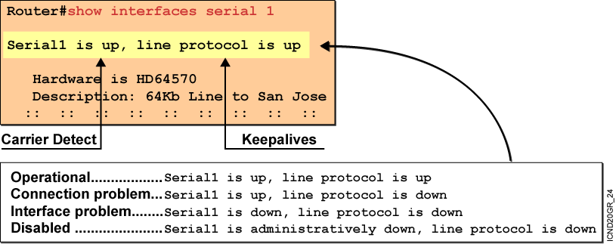
Interpreting the Interface Status
Notes:
Purpose: This slide explains how to interpret the show interfaces serial command output.
Emphasize: The show interfaces serial command output indicates that the serial interface is up and the line protocol is up. The first parameter refers to the hardware layer and essentially reflects whether the interface is receiving the Carrier Detect signal from the other end. The second parameter refers to the data link layer. This parameter reflects whether the data link layer protocol keepalives are being received.
If both the interface and the line protocol are up, the connection is operational.
If the hardware is up and the line protocol is down, a connection problem exist such as no clocking, wrong encapsulation type, or no keepalives.
If both the line protocol and the interface are down, a cable might never have been attached to the router. On the serial cable, you can plug in the cable upside-down, causing the pins on the serial cable to break.
There is one more possibility. If the information says “administratively down,” you have manually disabled (shut) the interface.
Cisco offers a hardware class (IMCR) that discusses the router hardware in more detail.

Slide 28
Verifying a Serial Interface Configuration
Router#show interface serial 0
Serial0 is up, line protocol is up
Hardware is HD64570
Internet address is 10.140.4.2/24
MTU 1500 bytes, BW 64 Kbit, DLY 20000 usec, rely 255/255, load 1/255
Encapsulation HDLC, loopback not set, keepalive set (10 sec)
Last input 00:00:09, output 00:00:04, output hang never
Last clearing of "show interface" counters never
Input queue: 0/75/0 (size/max/drops); Total output drops: 0
Queueing strategy: weighted fair
Output queue: 0/1000/64/0 (size/max total/threshold/drops)
Conversations 0/1/256 (active/max active/max total)
Reserved Conversations 0/0 (allocated/max allocated)
5 minute input rate 0 bits/sec, 0 packets/sec
5 minute output rate 0 bits/sec, 0 packets/sec
(output omitted)
BW 64 Kbit,
Notes:
Purpose: This slide shows how to verify the changes you make to an interface.
Emphasize: Notice the bandwidth has been changed to 64K from the default of 1.544M.

Slide 29
Serial Interface show controller Command
Router#show controller serial 0
HD unit 0, idb = 0x121C04, driver structure at 0x127078
buffer size 1524 HD unit 0, V.35 DTE cable
.
.
.
V.35 DTE Cable
Shows the cable type of serial cables
Notes:
Emphasize: This command requires a space between the word serial and the interface number. The router only checks for the cable type at powerup.

Slide 30
Summary
  From the privileged EXEC mode, you can enter global configuration mode, giving you access to the specific router configuration modes.
  Using the CLI, you will configure the router name, password, and other console commands.
  A router’s main function is to relay packets from one network device to another. To do that, you must define the characteristics of the interfaces through which the packets are received and sent.
  In a TCP/IP environment, end stations communicate seamlessly with servers or other end stations. This communication occurs because each node using the TCP/IP protocol suite has a unique 32-bit logical IP address.

Slide 31
Summary (Cont.)
  By dividing a network into smaller segments, or subnets, you can make the network address use more efficient. There is no change in how the outside world sees the network, but within the organization there is additional structure.
  A subnet address is created by borrowing bits from the host field and designating them as the subnet field. The number of borrowed bits is variable and specified by the subnet mask.
  Each interface on a Cisco router must have its own IP address to uniquely identify it on the network.
  When you complete the router interface configuration, you can verify it using show commands.

Slide 32
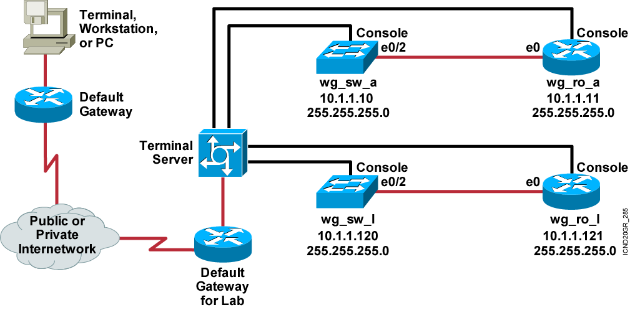
Visual Objective 1-1:
Cisco Remote Lab Connection

Slide 33
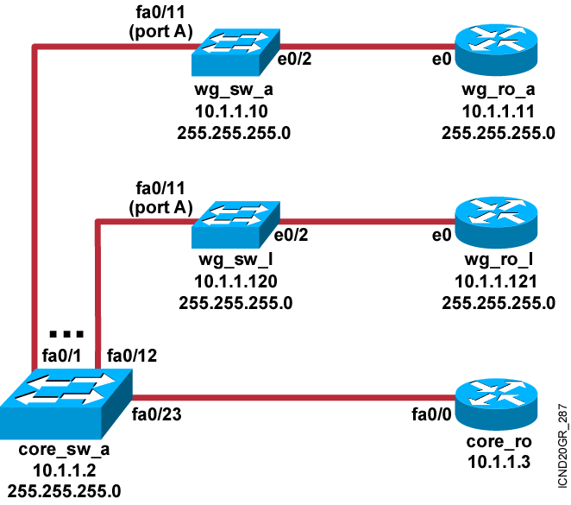
Visual Objective 1-2: Switch Startup and Initial Configuration
Pod Switch Router Ethernet
A 10.1.1.10 10.1.1.11
B 10.1.1.20 10.1.1.21
C 10.1.1.30 10.1.1.31
D 10.1.1.40 10.1.1.41
E 10.1.1.50 10.1.1.51
F 10.1.1.60 10.1.1.61
G 10.1.1.70 10.1.1.71
H 10.1.1.80 10.1.1.81
I 10.1.1.90 10.1.1.91
J 10.1.1.100 10.1.1.101
K 10.1.1.110 10.1.1.111
L 10.1.1.120 10.1.1.121
Notes:
Lab ?
Missing link core_ro ------core_sw_a. Fixed, kcm.

Slide 34
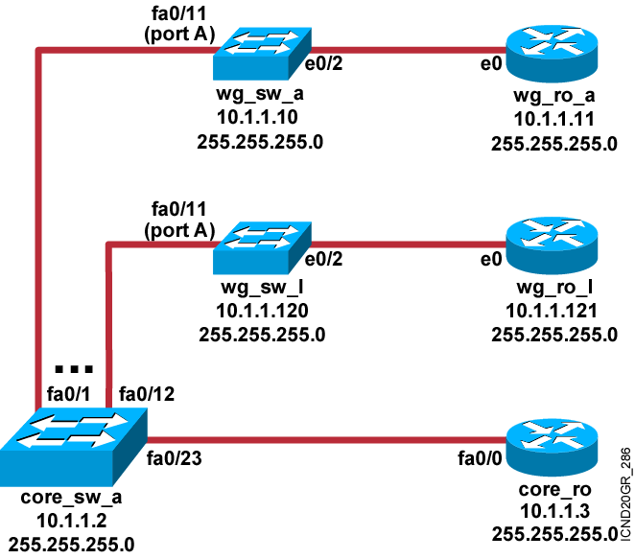
Visual Objective 1-3: Cisco Router Startup and Initial Configuration
Pod Switch Router Ethernet
A 10.1.1.10 10.1.1.11
B 10.1.1.20 10.1.1.21
C 10.1.1.30 10.1.1.31
D 10.1.1.40 10.1.1.41
E 10.1.1.50 10.1.1.51
F 10.1.1.60 10.1.1.61
G 10.1.1.70 10.1.1.71
H 10.1.1.80 10.1.1.81
I 10.1.1.90 10.1.1.91
J 10.1.1.100 10.1.1.101
K 10.1.1.110 10.1.1.111
L 10.1.1.120 10.1.1.121
Notes:
Emphasize: Refer to the lab setup guide for lab instructions.
Missing link between core_sw_a and core_ro. Fixed, kcm.
Is there anyway to make the addresses of the routers more generic? Because some labs will use 2500 (e0) and some 2600 (e0/0) ?
Which exercise? Assume lab 2

Slide 35
Visual Objective 1-4: Using the Router Command-Line Interface
Pod Switch Router Ethernet
A 10.1.1.10 10.1.1.11
B 10.1.1.20 10.1.1.21
C 10.1.1.30 10.1.1.31
D 10.1.1.40 10.1.1.41
E 10.1.1.50 10.1.1.51
F 10.1.1.60 10.1.1.61
G 10.1.1.70 10.1.1.71
H 10.1.1.80 10.1.1.81
I 10.1.1.90 10.1.1.91
J 10.1.1.100 10.1.1.101
K 10.1.1.110 10.1.1.111
L 10.1.1.120 10.1.1.121
Notes:
Lab ?
Missing link core_ro ------core_sw_a. Fixed, kcm.

Slide 36
Visual Objective 1-5: Operating and Configuring a Cisco IOS Device
Pod Switch Router Ethernet
A 10.1.1.10 10.1.1.11
B 10.1.1.20 10.1.1.21
C 10.1.1.30 10.1.1.31
D 10.1.1.40 10.1.1.41
E 10.1.1.50 10.1.1.51
F 10.1.1.60 10.1.1.61
G 10.1.1.70 10.1.1.71
H 10.1.1.80 10.1.1.81
I 10.1.1.90 10.1.1.91
J 10.1.1.100 10.1.1.101
K 10.1.1.110 10.1.1.111
L 10.1.1.120 10.1.1.121
Notes:
Lab ?
Missing link core_ro ------core_sw_a. Fixed, kcm.

Slide 37


